Slide 1




Slide 2
Aim of registry
To improve standards in ileal pouch surgery through a process of continuous national audit of activity and outcome in an observational registry
Notes:
national benchmark.

Slide 3
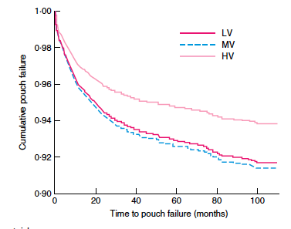
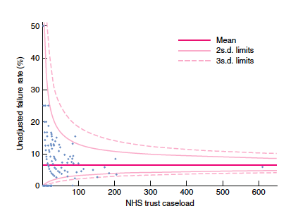
Rationale for registry
Reduce variation and improve quality through audit

Slide 4
How does it work?
Register online
Anonymous
Patient
confidentiality
Data owned by
individual units
Input data
Online form
Technical help
available
Annual report
Acknowledge
contributions
Allow units to
benchmark
their performance

Slide 5
Who are we?
ACPGBI IBD subcommittee
Chair Omar Faiz
Professor Nicholls, Justin Davies, Graeme Wilson, Steve Brown, Richard Lovegrove, Anna Wordley, Elaine Burns

Slide 6
Registry Address
http://demo.e-dendrite.com/csp/ilealpouch/frontpages/ ipdbfront.csp
Contacts
Queries on database o.faiz@imperial.ac.uk
Clinical support on database r.lovegrove@me.com
Technical Advice support@e-dendrite.com

